Slide 1
Bilateral Segmentation Network
Paper Summary

Slide 2
References
Changquian Yu¹ et al, BiSeNet: Bilateral Segmentation Network for Real-time Semantic Segmentation, ECCV 2018.
Changquian Yu¹ et al, BiSeNet V2: Bilateral Network with Guided Aggregation for Real-time Semantic Segmentation, International Journal of Computer Vision, 2021 (arXiv, 04/2020).
Mingyuan Fan² et al, Rethinking BiSeNet for Real-Time Semantic Segmentation, CVPR 2021.
Automation Lab – Sungkyunkwan University

Slide 3
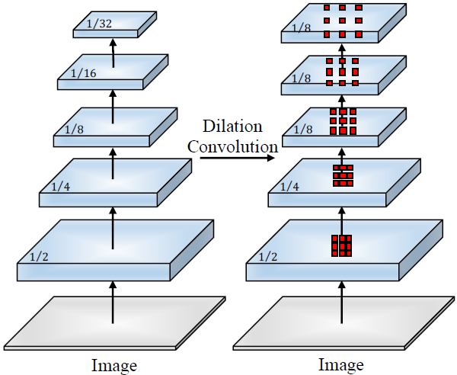
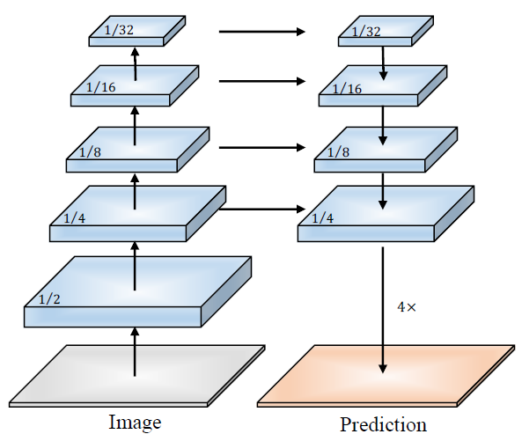
Generic Semantic Segmentation
Main FCN-based approaches:
Dilation backbone removes downsampling operations and upsamples convolution filter to preserve high-resolution feature representations (DeepLabv3, PSPNet). |  |  | Encoder-decoder backbone adds extra top-down and lateral connections to recover high-resolution feature maps in the decoder part (U-Net, SegNet).
 | Encode low-level details and high-level semantics simultaneously with wide and deep networks. Achieve SOTA performance; however, with heavy computation.

Slide 4
Real-time Segmentation
Common techniques to improve inference speed:
Input restricting or channel pruning → sacrifices spatial information, reduce accuracy
Stage dropping → shrinks receptive field, reduce accuracy
Lightweight backbone: Xception, MobileNet, ShuffleNet,… → Achieve good trade-off between speed and accuracy
Multi-branch architecture: ICNet (multi-scale image cascade), BiSeNet (multi-path)

Slide 5
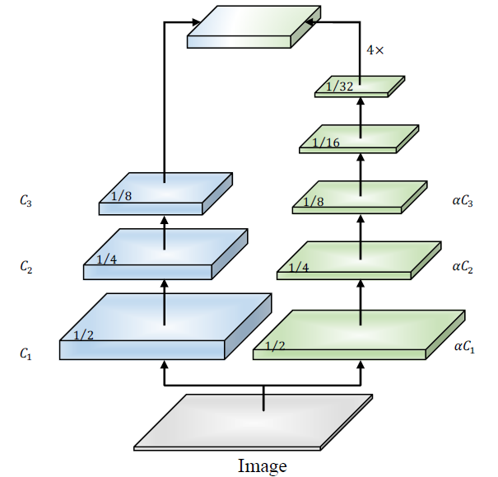
Core Concept of Bilateral Segmentation Network
Adopts multi-path framework:
Spatial Path has wide channels, shallow layers and small stride with small receptive field to encode rich spatial details.
Context Path has narrow channels and deep layers with large receptive field to capture categorical semantics.

Slide 6
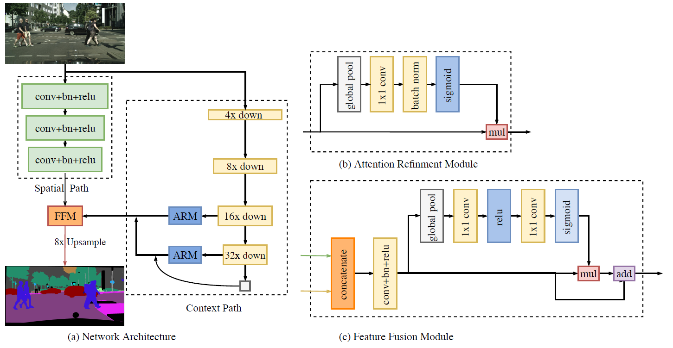
BiSeNet
ARM employs global average pooling to capture global context and computes an attention vector to guide the feature learning.
FFM concatenates features and computes weight vector for feature selection and combination.
Xception39/ResNet18
U-shape structure

Slide 7
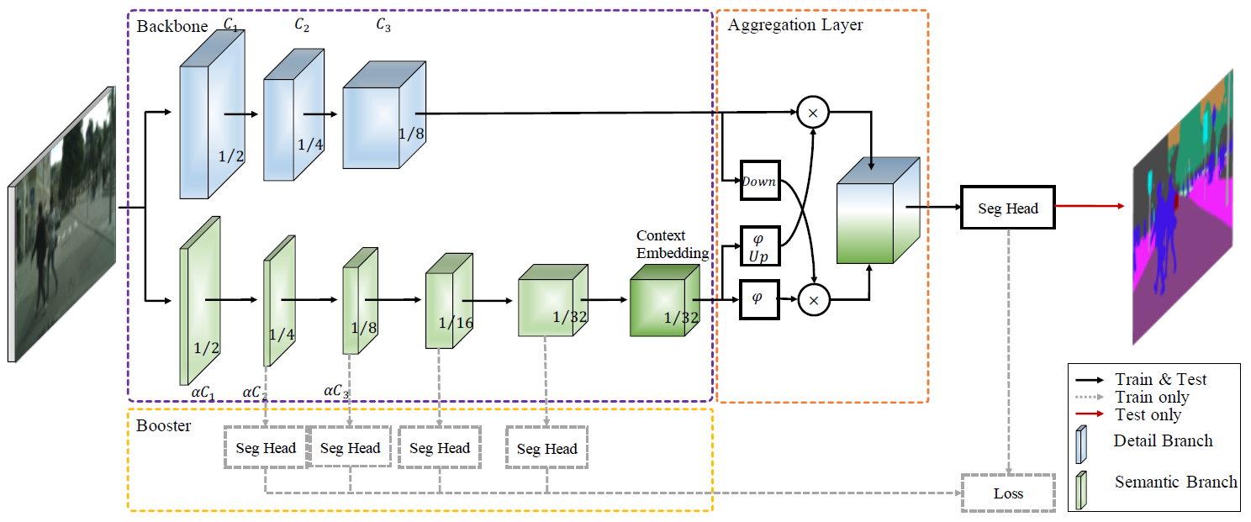
BiSeNet V2
Bilateral Guided Aggregation Layer fuses the features and encodes multi-scale information.
Spatial Path
Context Path
Lightweight network based on depth-wise conv., with Context Embedding block (global avg. pooling and residual connection) to embed global contextual information.
Booster training strategy inserts auxiliary segmentation heads to Context Path in training phase.

Slide 8
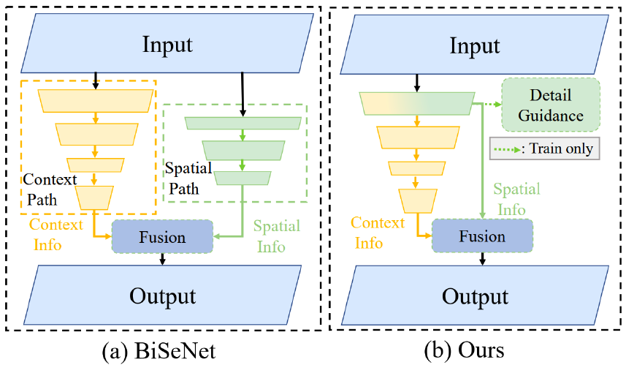
STDC - Short-Term Dense Concatenation Network
Backbone network is constructed from new SDTC module for feature extraction with variable receptive fields and multi-scale information.
Spatial and Context Paths are combined, and spatial details are extracted from low-level layers.
Attention Refinement Module (ARM) & Feature Fusion Module (FFM) are used in the same manner as in BiSeNet model.
STDC

Slide 9
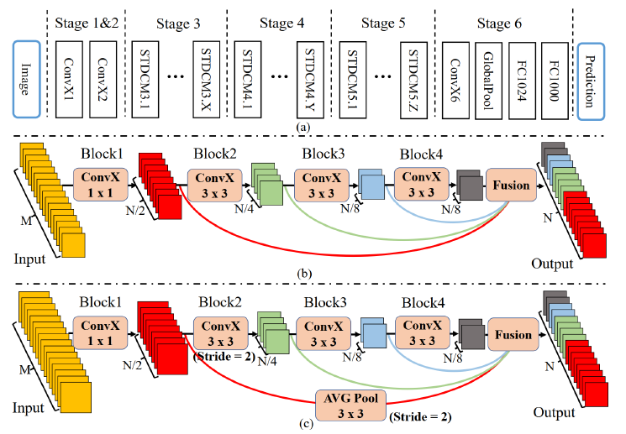
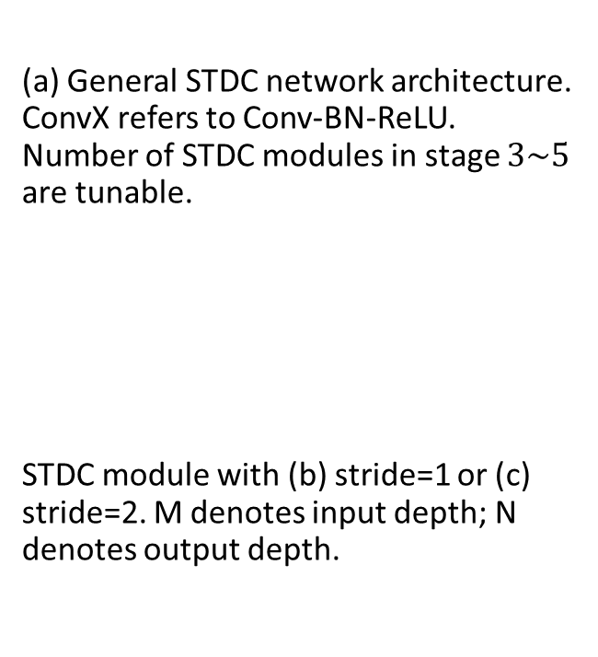
STDC - Short-Term Dense Concatenation Network
(a) General STDC network architecture. ConvX refers to Conv-BN-ReLU. Number of STDC modules in stage $3\sim 5$ are tunable.
STDC module with (b) stride=1 or (c) stride=2. M denotes input depth; N denotes output depth.

Slide 10
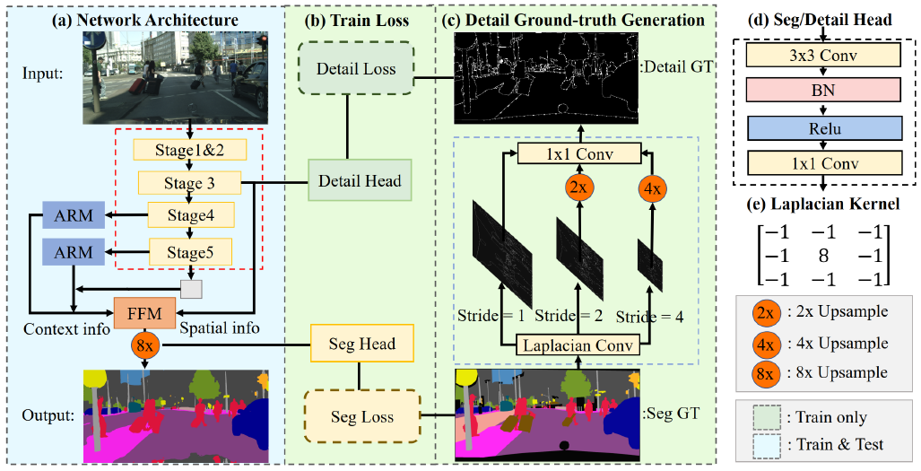
STDC - Short-Term Dense Concatenation Network
Detail Guidance Module guides low-level layers to learn spatial information from detail ground truth during training phase.
BiSeNet
STDC

Slide 11
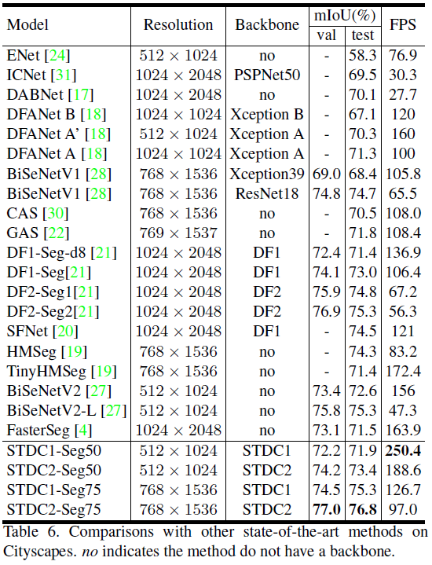
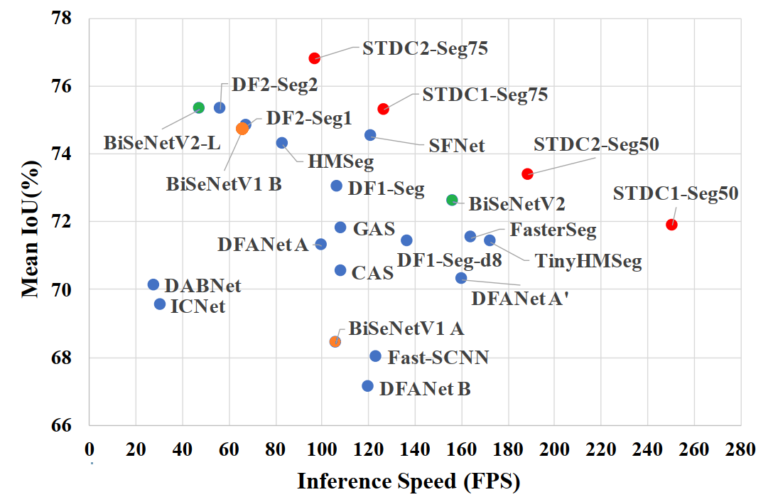
Benchmarks on Cityscapes

Slide 12
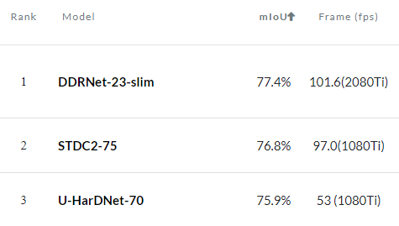
Significance
STDC2-75 holds 2nd rank in terms of mIOU in Real-time Semantic Segmentation on Cityscapes test leaderboard, while fps is approximately 25% faster than the 1st rank.
The model suitable for devices with limited resources.
STDC network maybe applicable in other dense processing tasks.

Slide 13
Thank you for listening

